Slide 1

MEDIA & THE PUBLIC
Week 3 Media coverage of politics
Ryan Wang
ryanyang@psu.edu

Slide 2
Why does (mass) media cover politics?

Slide 3
The function of (mass) media
The Jeffersonian dimension: a linkage institution between government and people
People → Government
Muckraking/Watchdog/Investigative journalism (e.g., Watergate)
Government → People
”Fireside chats”
Gatekeeping
Agenda-setting
The entertainment dimension
sports scores, information on lifestyle issues, gossip, etc.
The economic/business dimension
for-profit organization; maximize viewership (“All the News That’s Fit to Sell!”)

Slide 4
What types of (mass) media?

Slide 5
Typology of media outlet (Humprecht & Esser, 2016)
Private broadcasters (e.g., CNN, Fox News)
corporate-owned, strongly commercialized
Public broadcasters (e.g., PBS, NPR, BBC, NHK)
financed by fees, public or state funds with a primary public service mission, and a low degree of commercialization
Corporate newspapers (e.g., NYT, Washington Post)
owned by chain or stock exchange-listed company, strongly commercialized
Independent newspapers
alternative ownership form, moderate degree of commercialization
Popular newspapers (e.g., NYP)
tabloid-style mass market, strongly commercialized
Made-for-Web news providers (e.g., BuzzFeed, HuffPost)
either online-only pure player or – where nonexistent – online news provider with an independent profile and organizational structure

Slide 6
What Internet has changed our news outlet?

Slide 7
Mobilized/digitalized news
Sociological:
The lowered threshold for generating and distributing news
The content appealed to sub-groups at the expense of wider social cohesion
Political:
Public engagement at a personal level
”In a mobile era, consumption of news and engagement in politically inclined activities all occur within specific social contexts that blur the boundaries between the personal and the political.” (Duffy et al., 2020)
Socio-technological:
The changing definition of a journalist and the performance of journalistic act
“Moving from a we-tell-you-what-is-important function to providing spaces for non-journalists to engage in determining what is important and discuss why it is important” .” (Duffy et al., 2020)

Slide 8
Algorithmic news/journalism
Machine-generated news
Natural language generation (Example: the Guardian)
Machine-driven news (Feezell et al., 2021)
User-driven algorithms
based on past selections and assumed preferences of the individual user and has no known social network-related input
Socially driven algorithms
news contents based on both the user as well as their network.

Slide 9
Algorithmic news/journalism
Machine-driven news (Feezell et al., 2021)
User-driven algorithms: emphasizes the personal attributes and biases of citizens rather than their ties to other citizens (e.g., YouTube).
Users more likely to see news that’s seemingly popular, homogeneous across outlets, eschews public affairs, emphasizes national and business news, opinion pieces.
Users see much narrower set of topics and perspectives.
Expose users to increasingly negative and opinion-reinforcing information.
Socially driven algorithms: it takes into account user’s activities on SNS, and their ties to others in their network (e.g., Facebook, Twitter)
Depends on the ideological characteristics of user’s networks.
Online network grows, information diversifies.
Potential echo chamber? (still under debate)
May lead to additional information seeking, mitigate polarization.
Notes:
User-driven algorithms example: One example of a user-driven algorithm is YouTube, which explicitly only draws on user demographics, location, watch and search history to recommend videos (Covington, Adams and Sargin 2012).
Socially driven algorithms: example: Facebook, for example, explicitly admits to using social connections in generating content recommendations – hence the “Friend A and 30 other friends like this” under so many posts (Kabiljo & Aleksandar Ilic, 2015).

Slide 10
Key takeaways of Pew report
Greater portions of Republicans express distrust than express trust of 20 of the 30 sources asked about. Only seven outlets generate more trust than distrust among Republicans – including Fox News and the talk radio programs of hosts Sean Hannity and Rush Limbaugh.
Fox news phenomenon
Greater portions of Democrats express trust than express distrust in 22 of the 30 sources asked about. Only eight generate more distrust than trust – including Fox News, Sean Hannity and Rush Limbaugh.

Slide 11
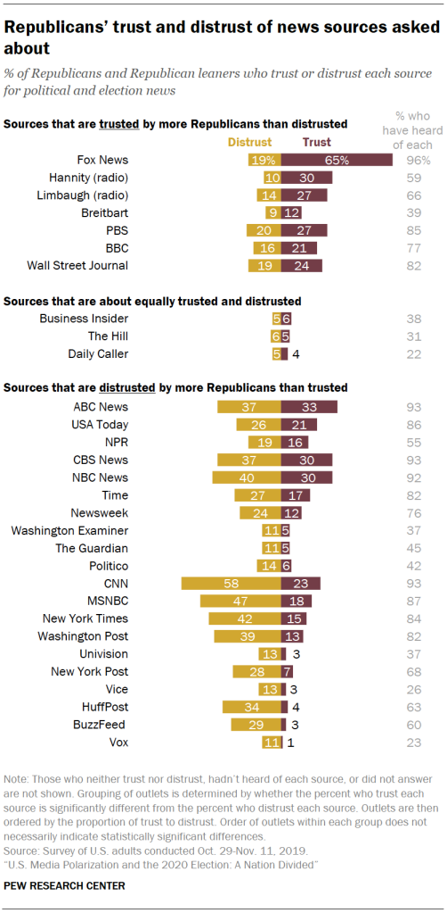
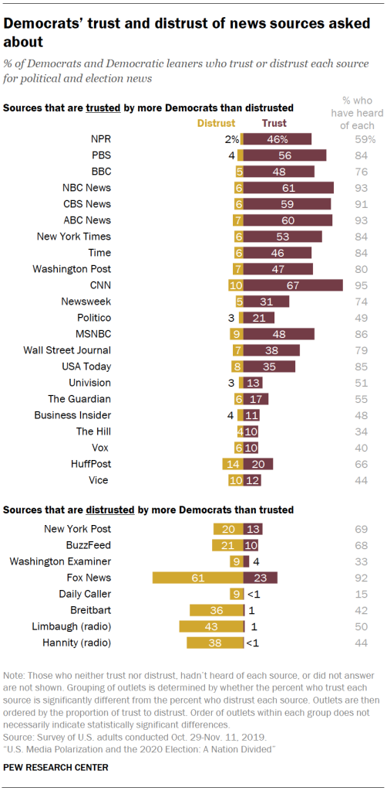

Slide 12
Key takeaways of Pew report
Partisan divides lead to one-sided audiences for many news outlets

Slide 13
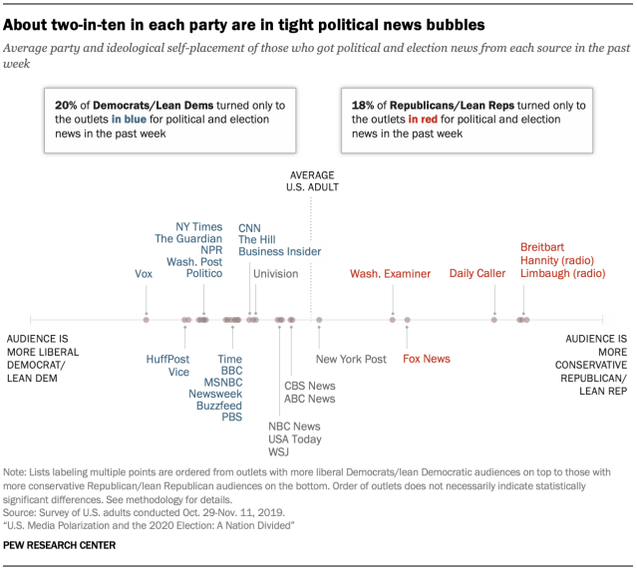

Slide 14
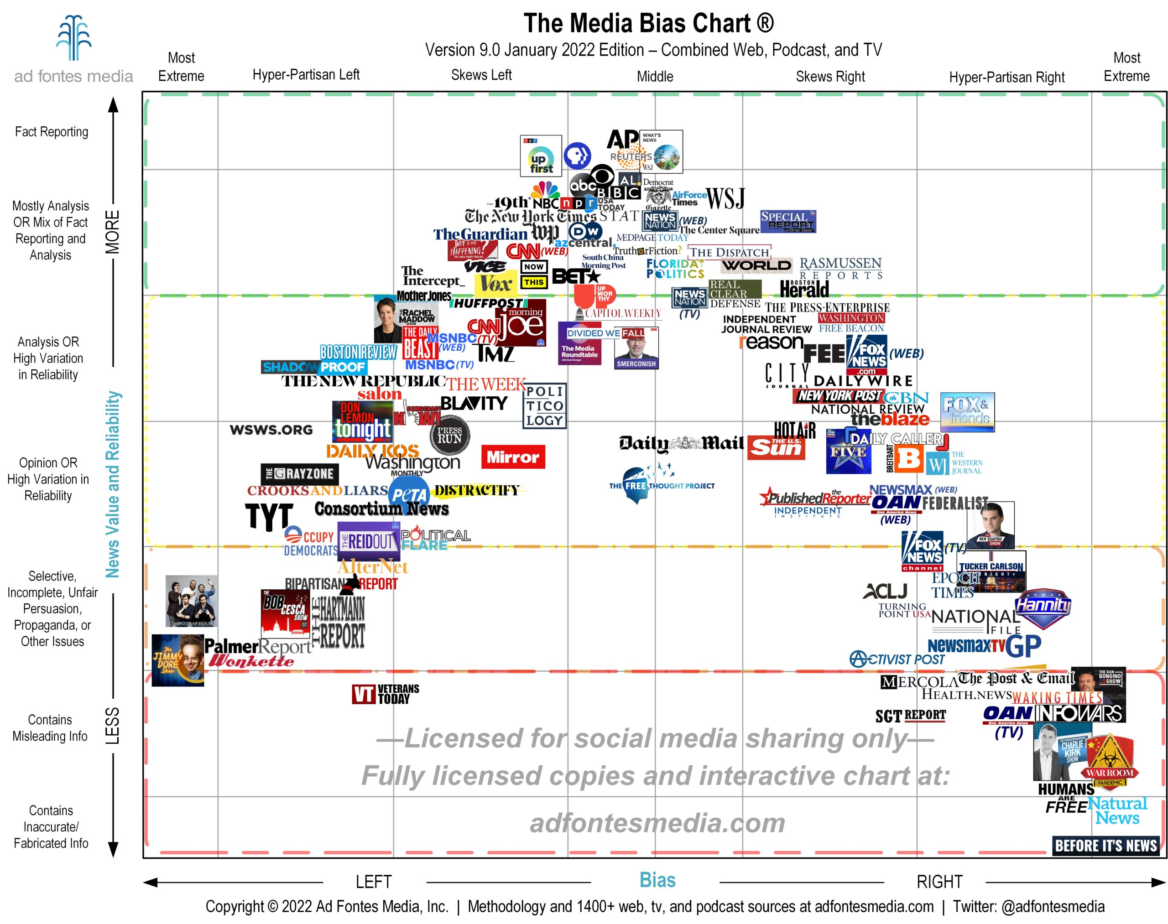
Source: Adfontesmedia

Slide 15
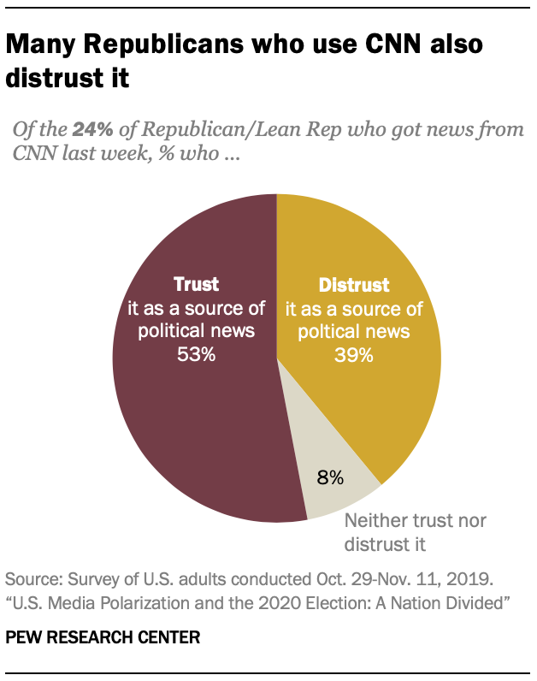
Key takeaways of Pew report
News consumption does NOT mean trust.

Slide 16
Key takeaways of Pew report
Partisan media divides have grown, largely driven by Republican distrust between 2014 and 2020

Slide 17
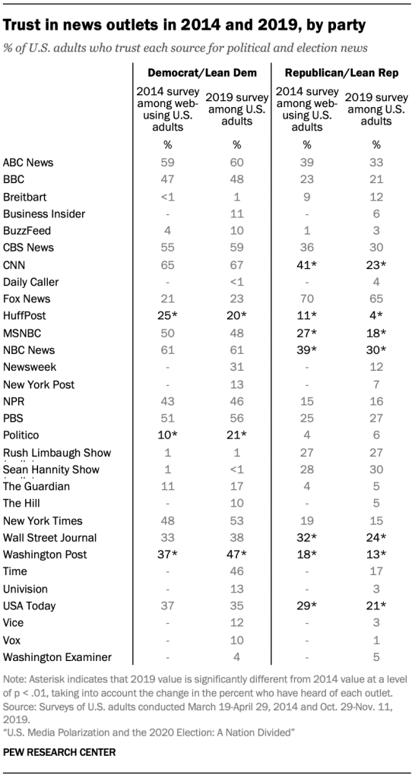
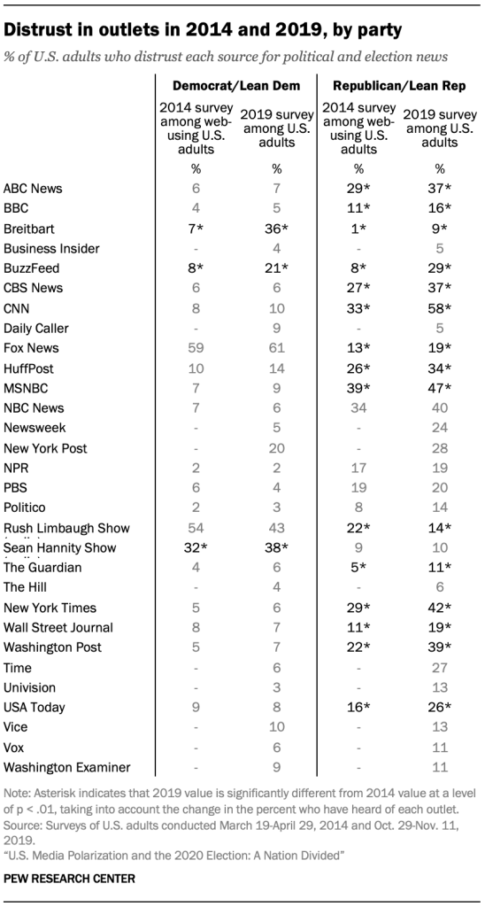

Slide 18
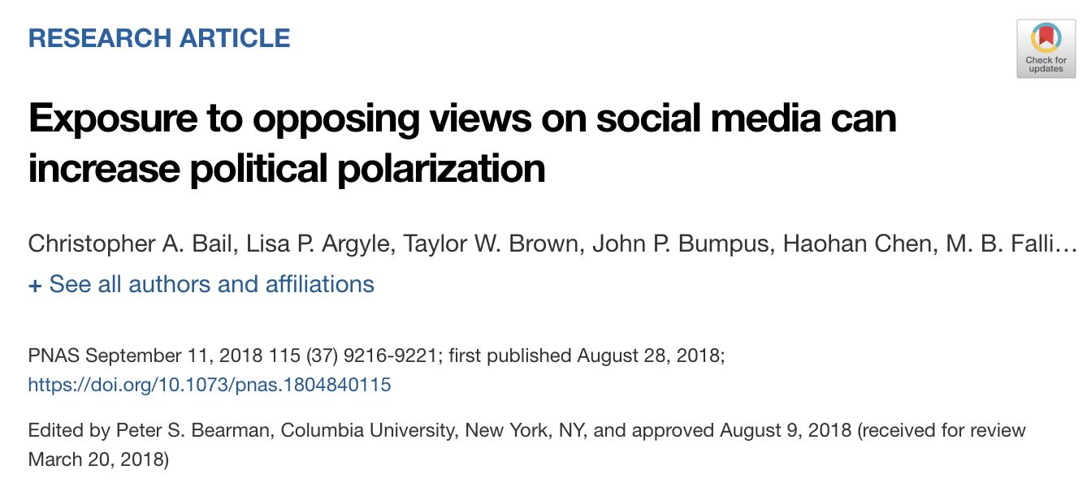
How do we fix it?
NEWS
Source: Bail et al. (2018)

